Slide 1




AT82.02
Data Modeling and Management
Unit 2-2: Document Model
Chutiporn Anutariya (chuti at ait dot ac dot th)

Slide 2

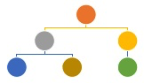
Document Model
RECAP

Slide 3

Document Model
A specialized Key-value Store but rather than storing “values,” it stores “documents”, which are not adhered to schema restrictions.
Provides a way to query the documents based on the contents or metadata.
Key
Document
AIT
China

Slide 4
Document Model
A specialized Key-value Store
Designed for storing, retrieving and managing document-oriented information, also known as semi-structured data, such as XML, JSON, BSON
Provides APIs or a query/update language that exposes the ability to query or update based on the internal structure in the document.

Slide 5
RECAP
{ "FirstName": "Bob", "Address": "5 Oak St.", "Hobby": "sailing" }
<contact> <firstname>Bob</firstname> <lastname>Smith</lastname> <phone type="Cell">(123) 555-0178</phone> <phone type="Work">(890) 555-0133</phone> <address> <type>Home</type> <street1>123 Back St.</street1> <city>Boys</city> <state>AR</state> <zip>32225</zip> <country>US</country> </address> </contact>

Slide 6
{ "FirstName": "Bob", "Address": "5 Oak St.", "Hobby": "sailing" }
<contact> <firstname>Bob</firstname> <lastname>Smith</lastname> <phone type="Cell">(123) 555-0178</phone> <phone type="Work">(890) 555-0133</phone> <address> <type>Home</type> <street1>123 Back St.</street1> <city>Boys</city> <state>AR</state> <zip>32225</zip> <country>US</country> </address> </contact>

Slide 7
CRUD Operations
Creation (or insertion)
Retrieval (or query, search, read or find)
Update (or edit)
Deletion (or removal)

Slide 8
About Document Model
Stores data in flexible, JSON-like documents
Fields can vary from document to document and data structure can be changed over time
Queries, indexing, and aggregation

Slide 9
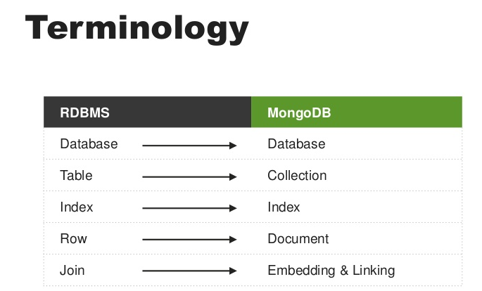
Example: MongoDB

Slide 10
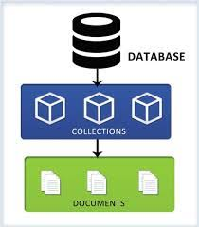
Database, Collections and Documents

Slide 11
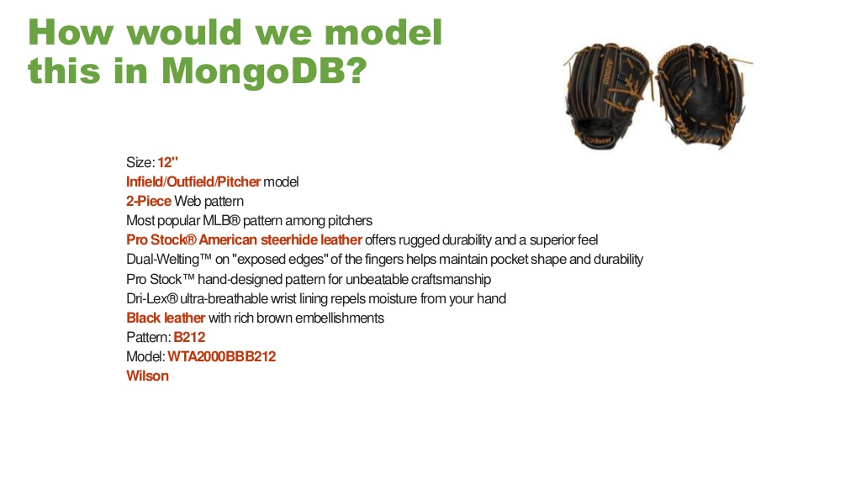
How to model this in JSON?

Slide 12
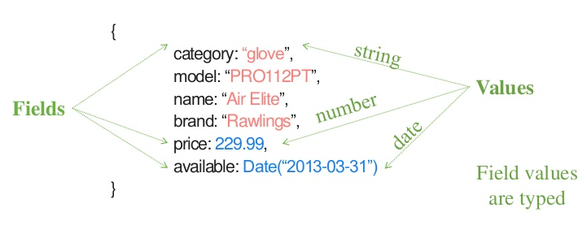
JSON Object

Slide 13
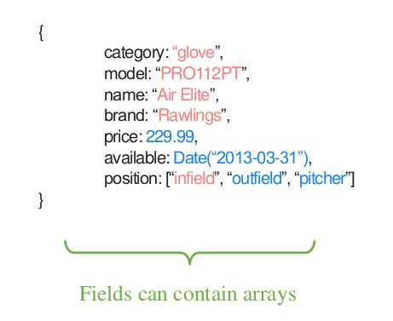
Documents are Rich Structures

Slide 14
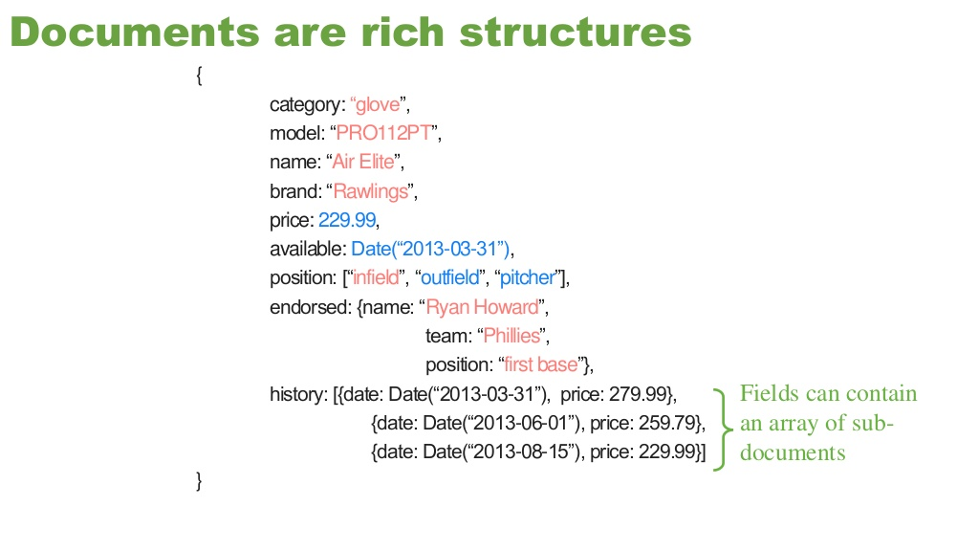
Documents are Rich Structures

Slide 15
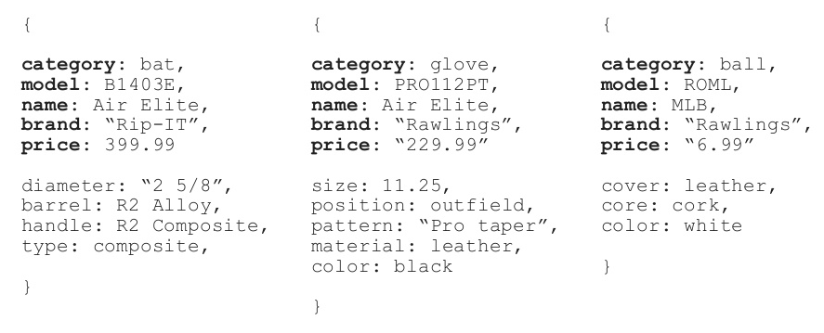
Variation is Easy!

Slide 16
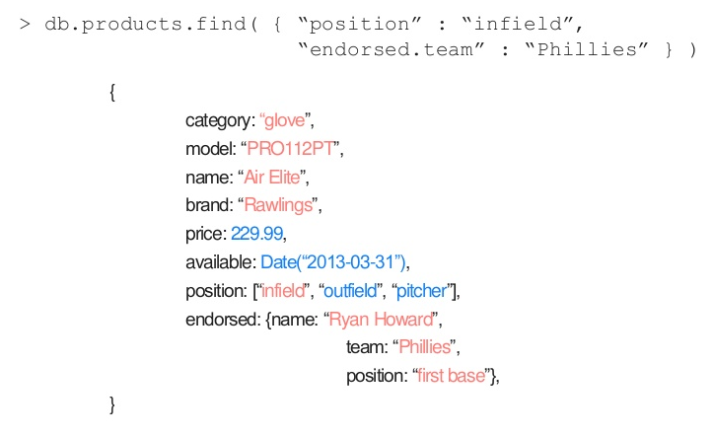
Easy Query! (MongoDB Query)

Slide 17
Object Relationships

Slide 18
1-1

Slide 19
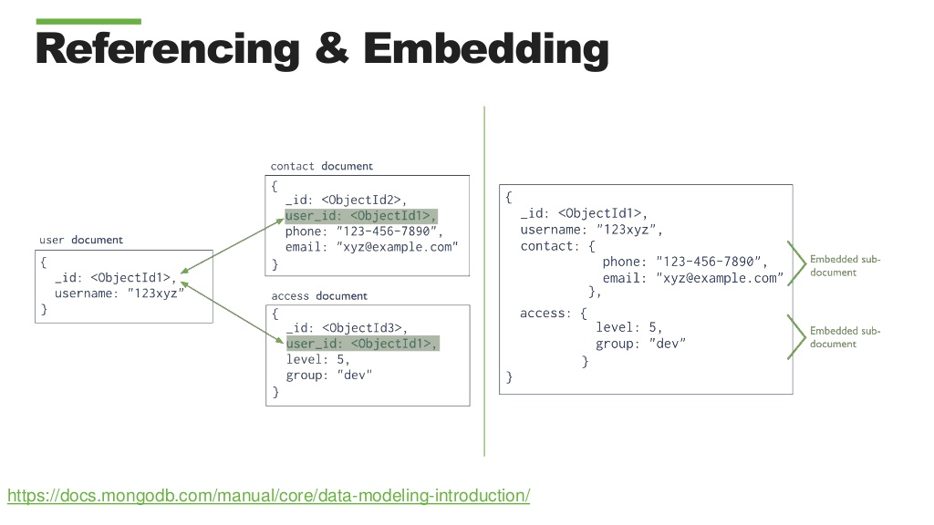

Slide 20
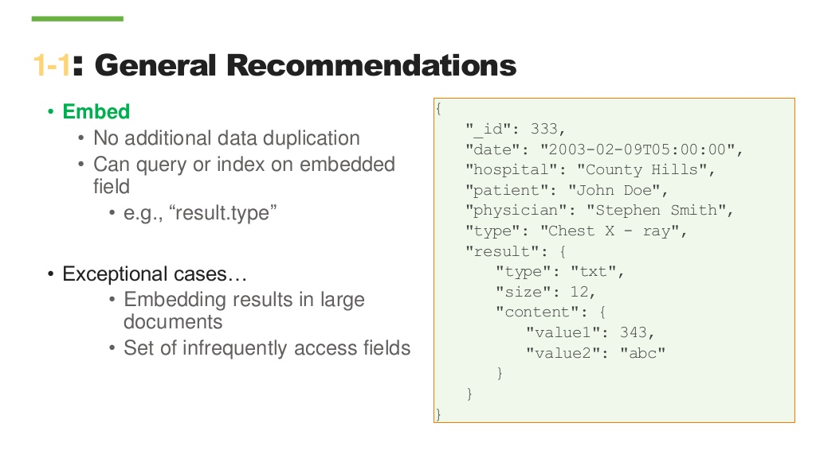

Slide 21
1-M

Slide 22
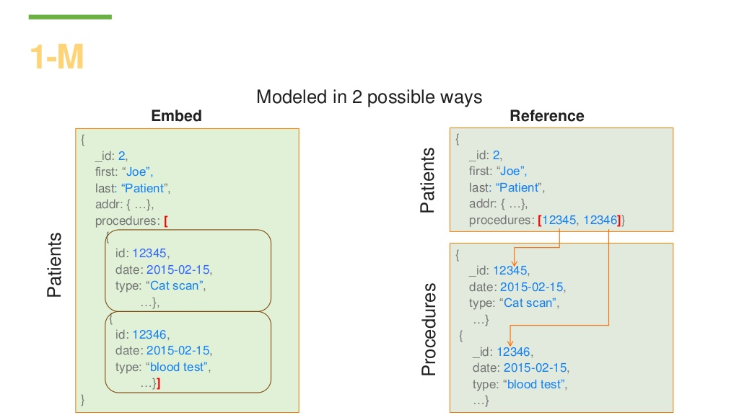

Slide 23
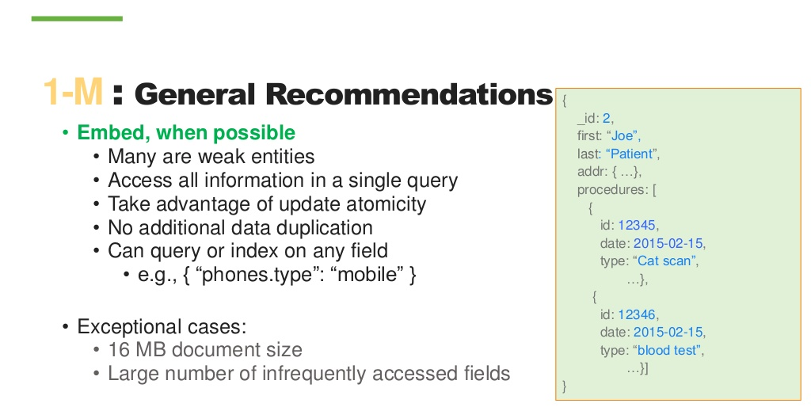

Slide 24
M-M

Slide 25
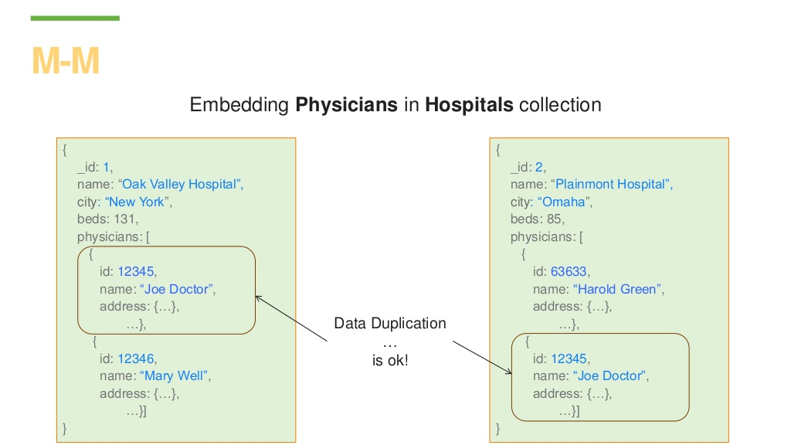

Slide 26
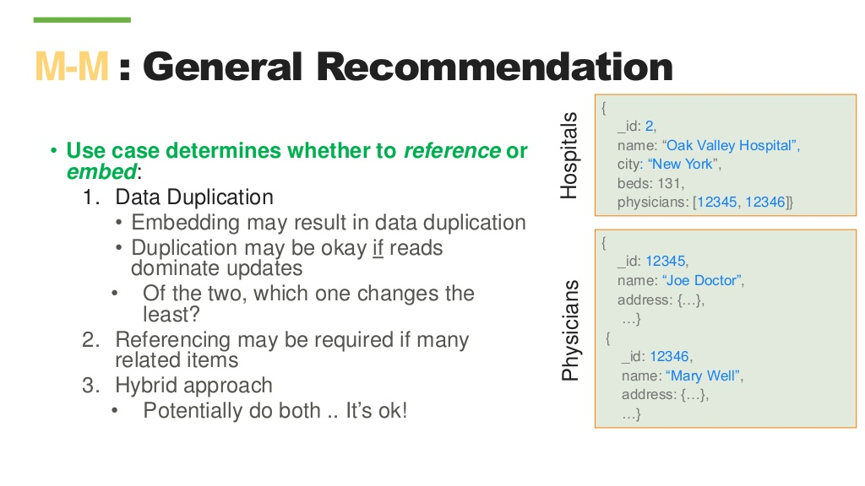

Slide 27

P. Sadalage and M. Fowler: NoSQL Distilled: A Brief Guide to the Emerging World of Polyglot Persistence, Addison-Wesley Professional, 2013
Jan L. Harrington: Relational Database Design and Implementation, 4th edition, Morgan Kaufmann, 2016
A. Makris, K. Tserpesa, V. Andronikou Dimosthenis Anagnostopoulos: A Classification of NoSQL Data Stores Based on Key Design Characteristics, Procedia Computer Science, Vol. 97, 2016, pp. 94-103.
MongoDB Schema Design: Practical Applications and Implications [https://www.slideshare.net/mongodb/mongodb-schema-design-practical-applications-and-implications]

